Slide 1

Code Coverage
Code coverage is a measure used to describe the degree to which the source code of a program is tested by a particular test suite.
High code coverage means
more thoroughly tested
has a lower chance of containing software bugs

Slide 2
Coverage criteria
Method coverage: Have all methods been called?
Decision/Branch Coverage: Have all decisions been executed in both the true and false paths?
Condition Coverage: Have all conditionals been executed in both the true and false paths?
Statement coverage: Have all statements in a method been executed?

Slide 3
Method Coverage
String getTriangle (int a, int b, int c) {
if (a == b && b == c) {
success();
return "Equilateral";
}
if (a == b || b == c || c == a) {
return "Isosceles";
}
return "Scalene";
}
void success()
{
printf(“Got it!”);
}
void testCoverage()
{
getTriangle(1,1,2);
getTriangle(2,2,2);
}

Slide 4
Condition Coverage
String getTriangle (int a, int b, int c) {
if (a == b && b == c) {
success();
return "Equilateral";
}
if (a == b || b == c || c == a) {
return "Isosceles";
}
return "Scalene";
}
void success()
{
printf(“Got it!”);
}
void testCoverage()
{
getTriangle(2,2,3);
getTriangle(2,2,2);
getTriangle(1,2,2);
getTriangle(2,1,2);
}

Slide 5
Branch Coverage
String getTriangle (int a, int b, int c) {
if (a == b && b == c) {
success();
return "Equilateral";
}
if (a == b || b == c || c == a) {
return "Isosceles";
}
return "Scalene";
}
void success()
{
printf(“Got it!”);
}
void testCoverage()
{
getTriangle(2,2,3);
getTriangle(2,2,2);
getTriangle(1,2,2);
getTriangle(2,1,2);
getTriangle(2,3,4);
}

Slide 6
Statement Coverage
String getTriangle (int a, int b, int c) {
if (a == b && b == c) {
success();
return "Equilateral";
}
if (a == b || b == c || c == a) {
return "Isosceles";
}
return "Scalene";
}
void success()
{
printf(“Got it!”);
}
void testCoverage()
{
getTriangle(2,2,3);
getTriangle(2,2,2);
getTriangle(1,2,2);
getTriangle(2,1,2);
getTriangle(2,3,4);
}

Slide 7
Benefits and Limitations
Benefits:
A measure of how complete your test cases are
High coverage does not guarantee code correctness!
Can identify paths through the code that you may have missed
Limitations:
The assumption that you are done testing if you have high coverage is incorrect
Coverage tools only tell you if you’ve covered what’s there
There may be requirements that you have missed!
Don’t write test cases ONLY to make your coverage tool happy
Inspect surrounding code for other potential errors, perhaps requirements you’ve missed

Slide 8
Code Coverage tools
djUnit- http://works.dgic.co.jp/djunit/
Eclipse plug‐in
Measures
Statement Coverage
Branch Coverage
EclEmma - http://eclemma.org/
Eclipse plug‐in
Measures (at the bytecode level)
Instruction Coverage
Block Coverage – roughly corresponds to condition coverage
Line Coverage
Method Coverage
Type Coverage
Clover - https://www.atlassian.com/software/clover/overview
Commercial tool
Method coverage
Statement coverage
Decision coverage

Slide 9
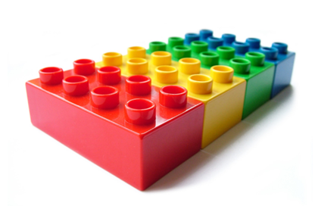
What is Unit testing?
Unit tests are whitebox tests written by developers, and designed to verify small units of program functionality.

Slide 10

When to write unit tests?
Unit tests are written by you, the developer, concurrently with implementation.

Slide 11
Good Unit Testing
Automatic: Run completely by itself, without any human input.
Atomic: Determine by itself whether the function it is testing has passed or failed, without a human interpreting the results
Single responsibility: Test exactly one feature
Independent: Run in isolation, separate from any other test cases (even if they test the same functions)
Repeatable: Multiple invocations of the test should consistently return the same value.

Slide 12

JUnit
Unit testing framework for the Java Programming Language.
Open source ( http://Junit.org )
Framework for both writing and automated execution of unit tests
Can be integrated with eclipse.

Slide 13
JUnit in Action
package edu.siu.cs435;
public class Math
{
public int add(int a, int b) {
return a + b;
}
public int sub(int a, int b) {
return a - b;
}
}

Slide 14
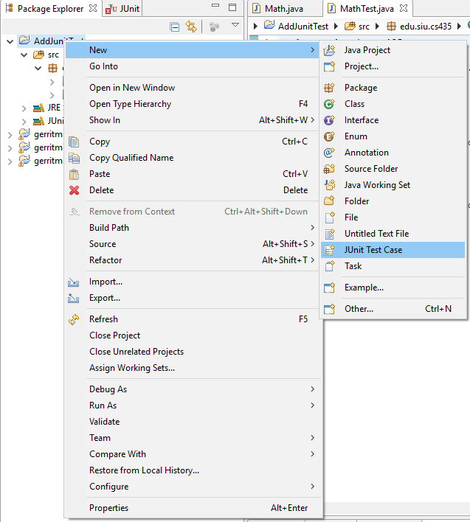
JUnit and Eclipse
To add JUnit to an Eclipse project, click:
Project → Properties → Build Path → Libraries → Add Library... → JUnit → JUnit 4 → Finish
To create a test case:
right-click a file and choose New → Test Case
or click File → New → JUnit Test Case
Eclipse can create stubs of method tests for you.

Slide 15
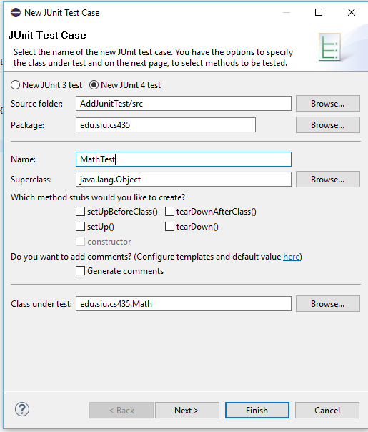
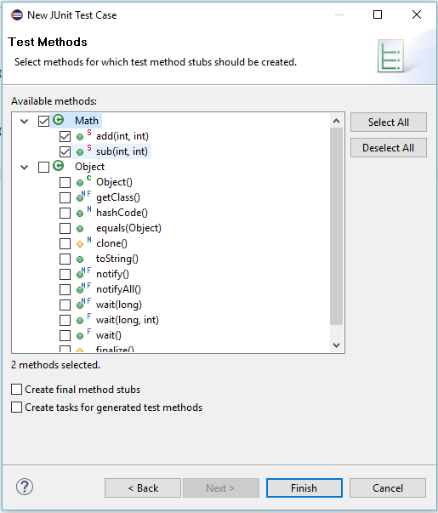
Junit in Eclipse

Slide 16
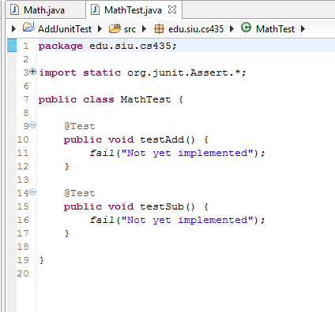

Slide 17
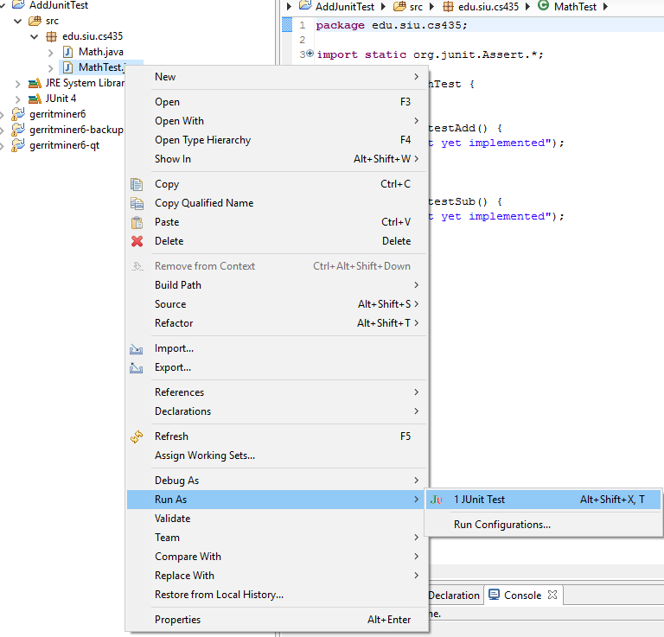

Slide 18
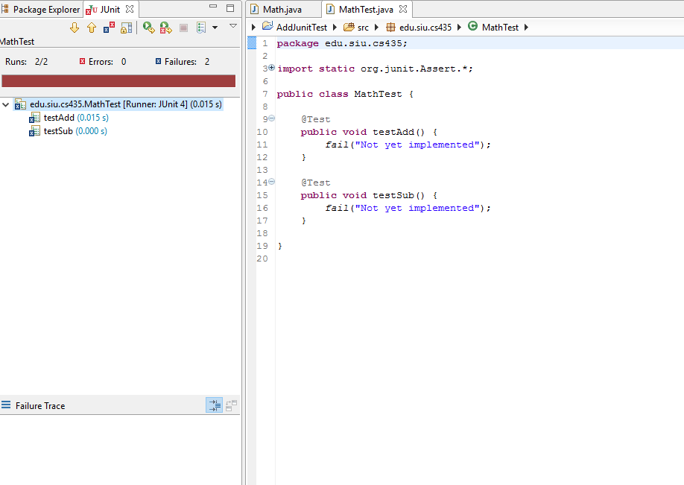

Slide 19
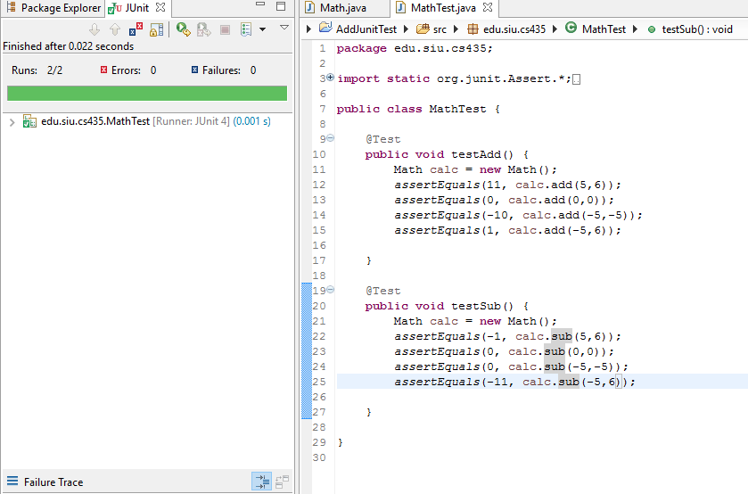

Slide 20
JUnit assertion methods
assertTrue(test) | fails if the boolean test is false
assertFalse(test) | fails if the boolean test is true
assertEquals(expected, actual) | fails if the values are not equal
assertSame(expected, actual) | fails if the values are not the same (by ==)
assertNotSame(expected, actual) | fails if the values are the same (by ==)
assertNull(value) | fails if the given value is not null
assertNotNull(value) | fails if the given value is null
fail() | causes current test to immediately fail
Each method can also be passed a string to display if it fails:
e.g. assertEquals("message", expected, actual)

Slide 21
Junit Framework
Provides following important features
Fixtures
Test suites
Test runners
JUnit classes

Slide 22
Fixtures
Fixtures is a fixed state of a set of objects used as a baseline for running tests. The purpose of a test fixture is to ensure that there is a well known and fixed environment in which tests are run so that results are repeatable.
@Before
Performs this function before each test case
Since each of the tests are independent, each test will receive its own instance of whatever is created in the @Before methods
@Test
Indicates individual test cases
Must be present to tell JUnit which methods are tests and which are helpers
@After
The teardown after each test case
Usually need to worry about this only if you have created external resources

Slide 23
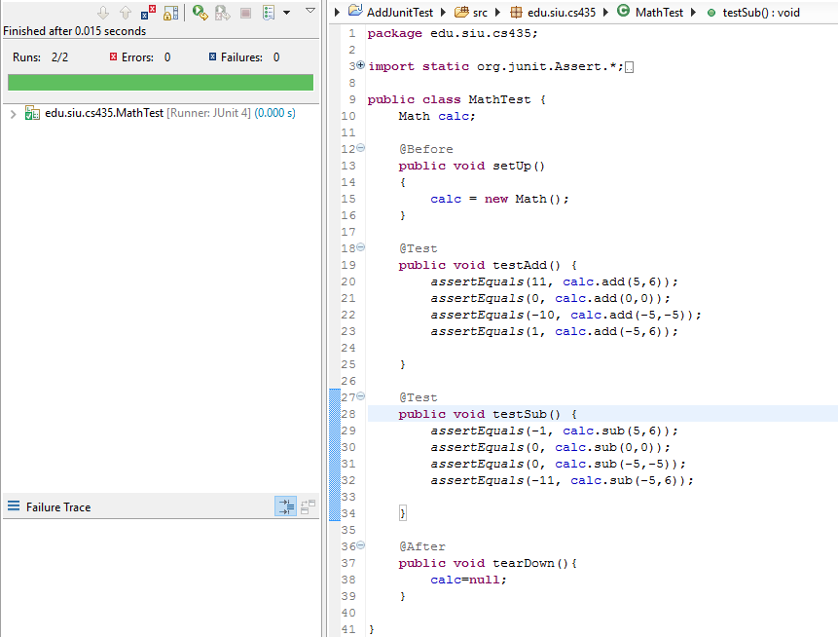

Slide 24
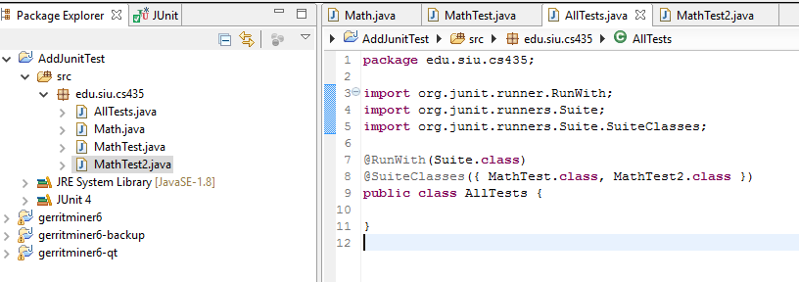
Test Suite
Test suite means bundle a few unit test cases and run it together. In JUnit, both @RunWith and @Suite annotation are used to run the suite test.

Slide 25
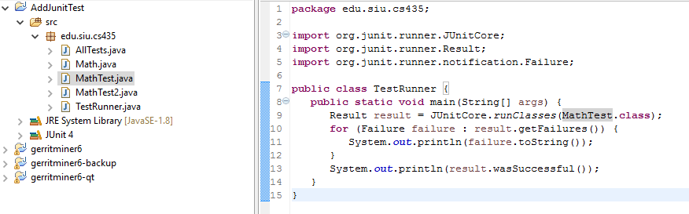
Test Runner
Test runner is used for executing the test cases.

Slide 26
JUnit exercise
Given a Date class with the following methods:
public Date(int year, int month, int day)
public Date() // today
public int getDay(), getMonth(), getYear()
public void addDays(int days) // advances by days
public int daysInMonth()
public String dayOfWeek() // e.g. "Sunday"
public boolean equals(Object o)
public boolean isLeapYear()
public void nextDay() // advances by 1 day
public String toString()
Come up with unit tests to check the following:
That no Date object can ever get into an invalid state.
That the addDays method works properly.
It should be efficient enough to add 1,000,000 days in a call.
Notes:
a good equals method has some initial checks like checking for null, checking whether this == that, check instanceof, etc... then it calls compareTo

Slide 27
What's wrong with this?
public class DateTest {
@Test
public void test1() {
Date d = new Date(2050, 2, 15);
d.addDays(4);
assertEquals(d.getYear(), 2050);
assertEquals(d.getMonth(), 2);
assertEquals(d.getDay(), 19);
}
@Test
public void test2() {
Date d = new Date(2050, 2, 15);
d.addDays(14);
assertEquals(d.getYear(), 2050);
assertEquals(d.getMonth(), 3);
assertEquals(d.getDay(), 1);
}
}

Slide 28
Well-structured assertions
public class DateTest {
@Test
public void test1() {
Date d = new Date(2050, 2, 15);
d.addDays(4);
assertEquals(2050, d.getYear()); // expected
assertEquals(2, d.getMonth()); // value should
assertEquals(19, d.getDay()); // be at LEFT
}
@Test
public void test2() {
Date d = new Date(2050, 2, 15);
d.addDays(14);
assertEquals("year after +14 days", 2050, d.getYear());
assertEquals("month after +14 days", 3, d.getMonth());
assertEquals("day after +14 days", 1, d.getDay());
} // test cases should usually have messages explaining
} // what is being checked, for better failure output

Slide 29
Expected answer objects
public class DateTest {
@Test
public void test1() {
Date d = new Date(2050, 2, 15);
d.addDays(4);
Date expected = new Date(2050, 2, 19);
assertEquals(expected, d); // use an expected answer
} // object to minimize tests
// (Date must have toString
@Test // and equals methods)
public void test2() {
Date d = new Date(2050, 2, 15);
d.addDays(14);
Date expected = new Date(2050, 3, 1);
assertEquals("date after +14 days", expected, d);
}
}

Slide 30
Naming test cases
public class DateTest {
@Test
public void test_addDays_withinSameMonth_1() {
Date actual = new Date(2050, 2, 15);
actual.addDays(4);
Date expected = new Date(2050, 2, 19);
assertEquals("date after +4 days", expected, actual);
}
// give test case methods really long descriptive names
@Test
public void test_addDays_wrapToNextMonth_2() {
Date actual = new Date(2050, 2, 15);
actual.addDays(14);
Date expected = new Date(2050, 3, 1);
assertEquals("date after +14 days", expected, actual);
}
// give descriptive names to expected/actual values
}

Slide 31
What's wrong with this?
public class DateTest {
@Test
public void test_addDays_addJustOneDay_1() {
Date actual = new Date(2050, 2, 15);
actual.addDays(1);
Date expected = new Date(2050, 2, 16);
assertEquals(
"should have gotten " + expected + "\n" +
" but instead got " + actual\n",
expected, actual);
}
...
}

Slide 32
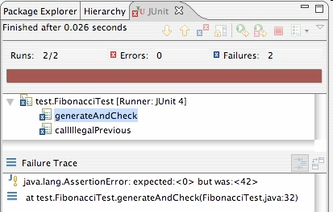
Good assertion messages
public class DateTest {
@Test
public void test_addDays_addJustOneDay_1() {
Date actual = new Date(2050, 2, 15);
actual.addDays(1);
Date expected = new Date(2050, 2, 16);
assertEquals("adding one day to 2050/2/15",
expected, actual);
}
...
}
// JUnit will already show
// the expected and actual
// values in its output;
//
// don't need to repeat them
// in the assertion message

Slide 33
Tests with a timeout
@Test(timeout = 5000)
public void name() { ... }
The above method will be considered a failure if it doesn't finish running within 5000 ms
private static final int TIMEOUT = 2000;
...
@Test(timeout = TIMEOUT)
public void name() { ... }
Times out / fails after 2000 ms

Slide 34
Pervasive timeouts
public class DateTest {
@Test(timeout = DEFAULT_TIMEOUT)
public void test_addDays_withinSameMonth_1() {
Date d = new Date(2050, 2, 15);
d.addDays(4);
Date expected = new Date(2050, 2, 19);
assertEquals("date after +4 days", expected, d);
}
@Test(timeout = DEFAULT_TIMEOUT)
public void test_addDays_wrapToNextMonth_2() {
Date d = new Date(2050, 2, 15);
d.addDays(14);
Date expected = new Date(2050, 3, 1);
assertEquals("date after +14 days", expected, d);
}
// almost every test should have a timeout so it can't
// lead to an infinite loop; good to set a default, too
private static final int DEFAULT_TIMEOUT = 2000;
}

Slide 35
Testing for exceptions
@Test(expected = ExceptionType.class)
public void name() {
...
}
Will pass if it does throw the given exception.
If the exception is not thrown, the test fails.
Use this to test for expected errors.
@Test(expected = ArrayIndexOutOfBoundsException.class)
public void testBadIndex() {
ArrayIntList list = new ArrayIntList();
list.get(4); // should fail
}

Slide 36
Setup and teardown
@Before
public void name() { ... }
@After
public void name() { ... }
methods to run before/after each test case method is called
@BeforeClass
public static void name() { ... }
@AfterClass
public static void name() { ... }
methods to run once before/after the entire test class runs

Slide 37
Other Unit Testing Frameworks
NUnit (http://www.nunit.org/)
.NET languages
PHP Unit (https://phpunit.de/ )
PHP

